Slide 1
AVID College Project

Slide 2
Requirements
College Pennant
Minimum 6 sub-levels of pennant + Cover
Photo shopped picture of you at the University (level 7)
(I will show you how to do this)
Summary concludes
each level

Slide 3
Demographic Data
Colleges & Major
Campus Life – Dorms & Off-Campus Housing
Scholarships
Career Data
Freshman Entrance Requirements

Slide 4
College Pennant
You will receive 1 cardstock pennant to showcase your University.
the name of the school, their mascot or official seal, your name
Your pennant should be appealing to attract people to your university.
We will have a Gallery walk with a rubric to grade your University Pennants.
Due Nov 1st

Slide 5
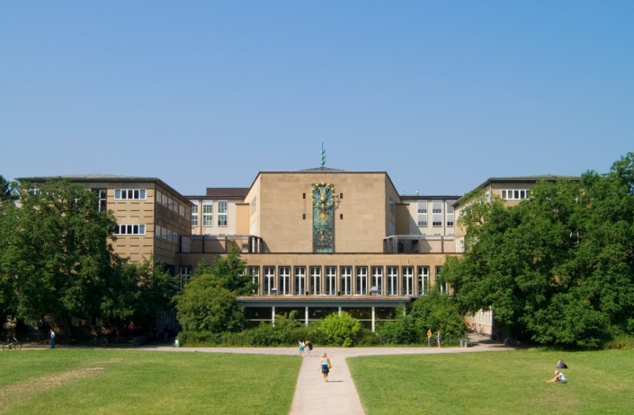
2. History/Demographic Data
The history of the school
demographics of the campus
location
climate
unique features
school’s colors and mascots, including the history behind these.
Colleges and prominent majors offered

Slide 6
3. Your College/Major
Majors offered
Statistics
Salary ranges for occupations
School’s strengths and weaknesses

Slide 7
4. Campus Life
Extra-curricular Activities
Clubs
Organizations
Professional affiliations
information about the social life on campus and the opportunities or extra-curricular possibilities.

Slide 8
5. Career Data
Choose a field of concentration that you are be interested in pursuing. Do a detailed analysis of the courses which will be required for this major and a detailed discussion of professional possibilities which will be open to you with this major How many years of school does this career require?
Explain your career.
How much money do you stand to earn?
Day in the Life
Salary Ranges
AZ, CA, TX, NY, IL

Slide 9
6. Scholarships
Locate scholarships for your major
College specific scholarships
List the following:
Amount
Requirements
Website url
Filing Deadlines
Special Details

Slide 10
7. My Campus
Picture of You photo-shopped in or actually at the campus
Pictures of various aspects of the campus
Dorms
Library/Computer Commons
Classroom

Slide 11
Complete Project Due WED
Nov 14, 2012

Slide 12
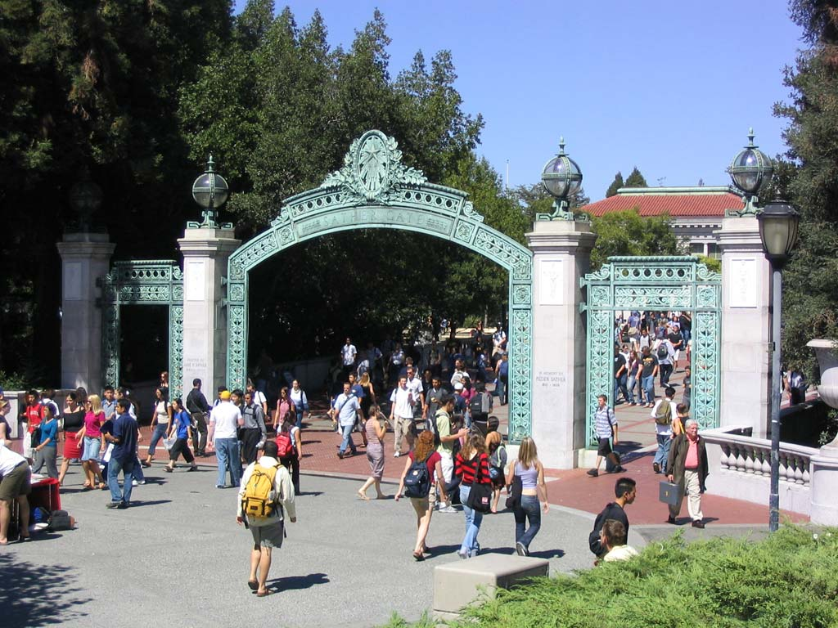
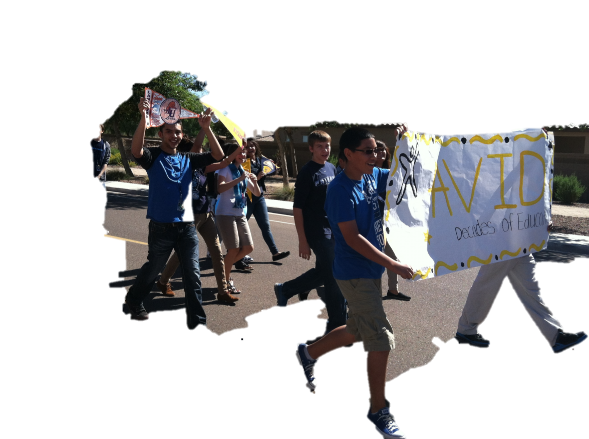
Photo shopped picture of you at your university.
Using microsoft Paint or another picture editing program make a picture of yourself at your university.
Due Nov 7

Slide 13
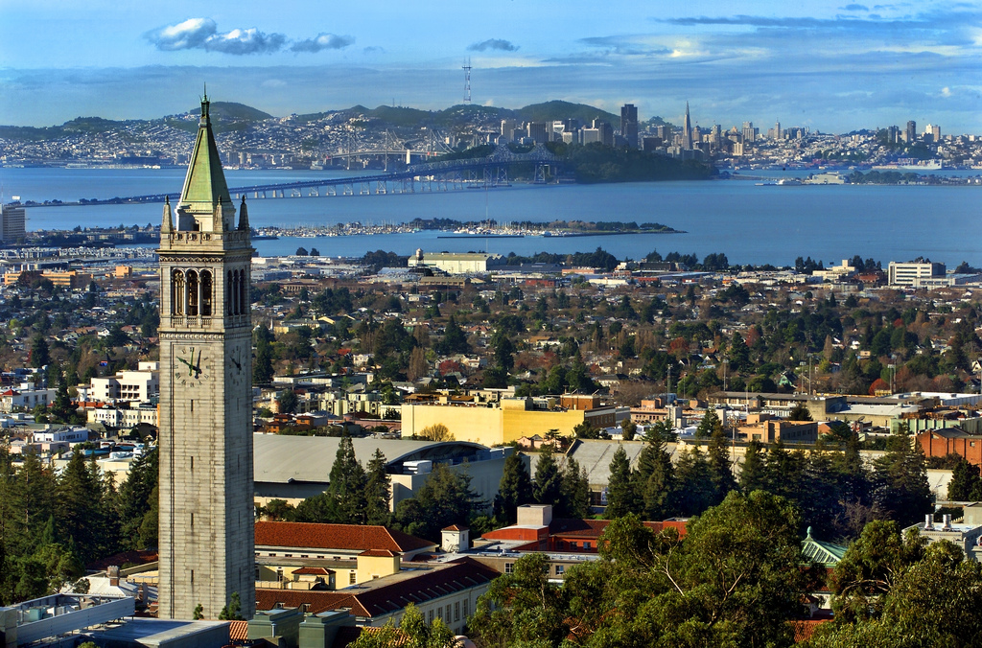

Slide 15
Writing options
Persuade another student to attend this school
Persuade your parents to let you attend this school
Write an analytical assessment of the schools strengths and weaknesses
Write a letter home as if you were a student at the school just starting the second semester of your freshman year
Due May 4

